Slide 1
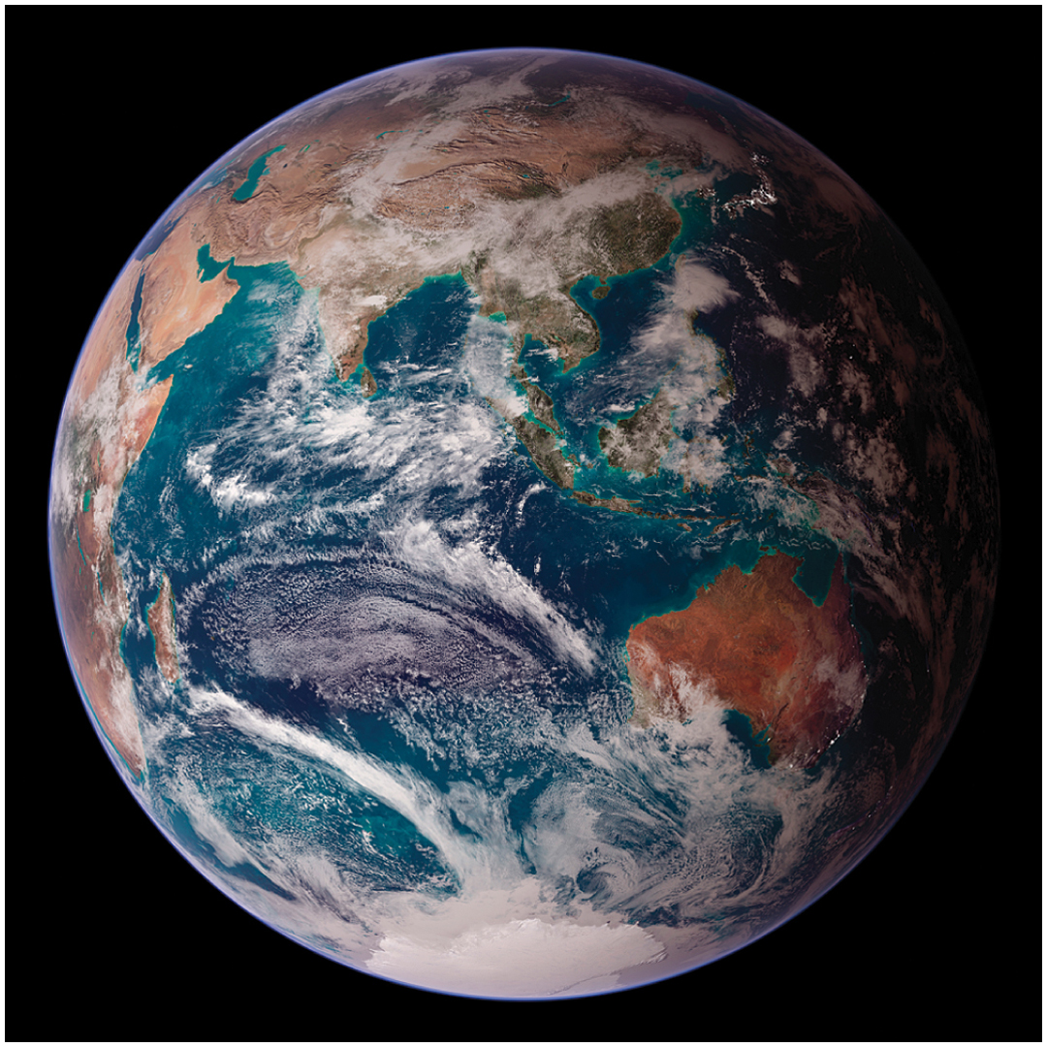

Chapter 3-Introduction to the Atmosphere

Slide 2
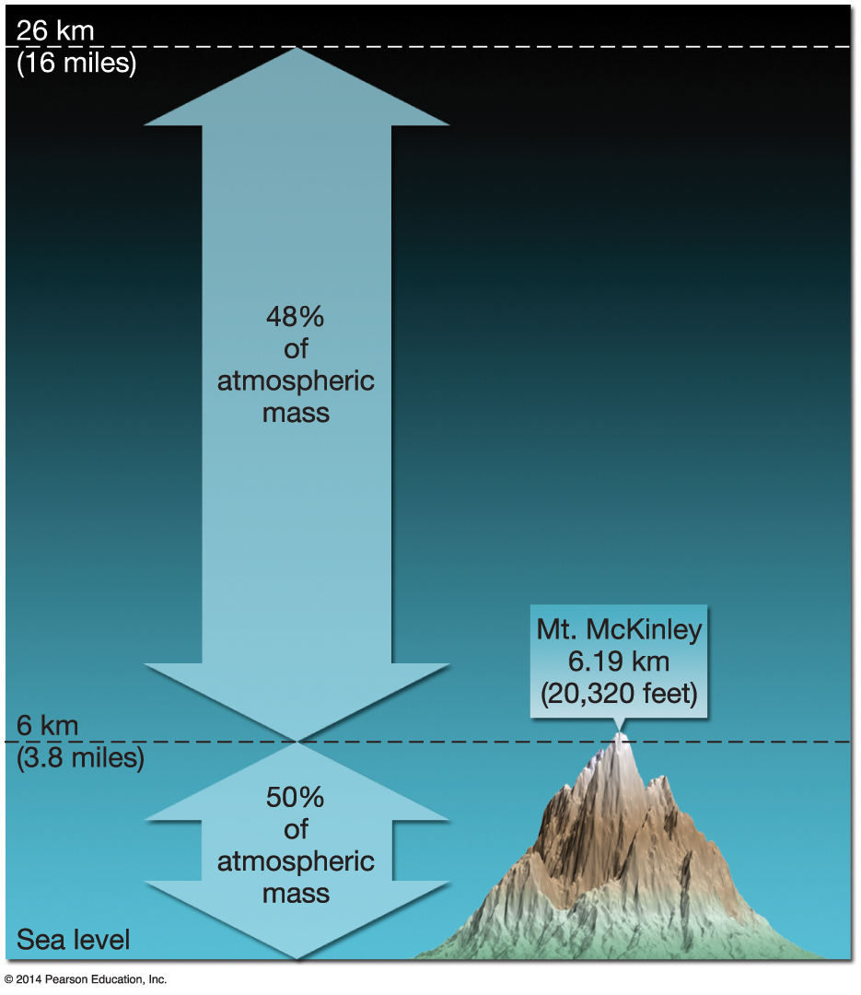

Size and Composition of the Atmosphere
Atmosphere uniformly surrounds Earth
Held down by Earth’s gravity
Extends up to 10,000 km from the surface
More than 50% of the total mass is below 6 km
Development of the atmosphere
Notes:
Early atmosphere was hydrogen and helium. 4 b.y.a. Volcanic eruptions carbon dioxide and water vapor released. As ancient earth cooled caused water vapor to condense. By 3.5 bya early forms of life replacing carbon dioxide with oxygen.

Slide 3
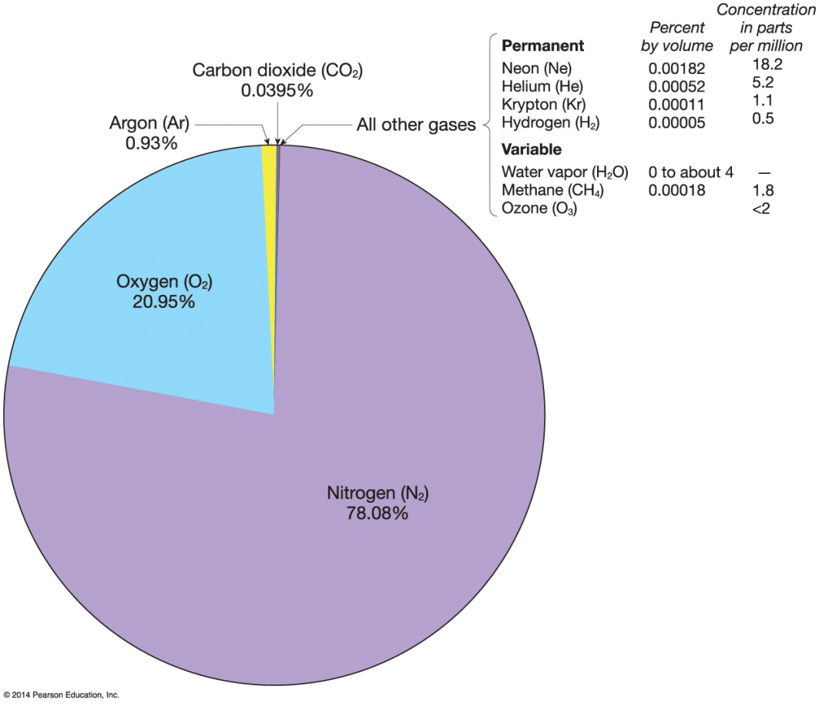

Composition of the Atmosphere
Two primary gas types
Permanent
Oxygen and nitrogen
Variable
Water vapor
Carbon dioxide
Ozone
Other variable gases
Permanent gases make up over 95% of total atmosphere
Notes:
Permanent means they are unvarying over time.
Variable that they change over time and from location to location.

Slide 4
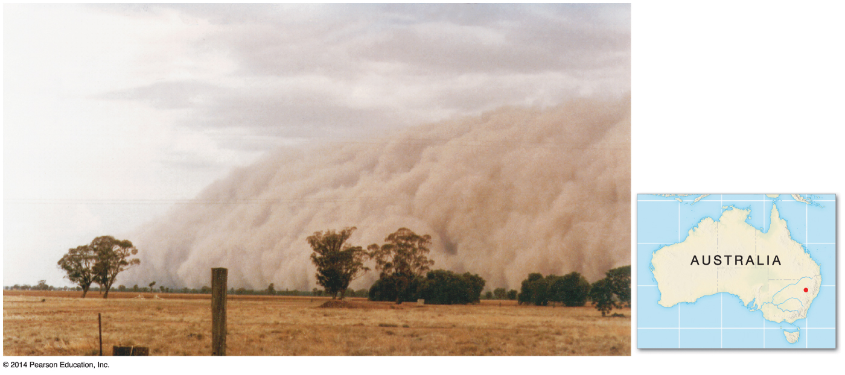

Composition of the Atmosphere
Particulates
Non-gaseous particles that exist in the atmosphere
Many human-induced and natural types
Many are hygroscopic
Some reflect or absorb sunlight
Notes:
Hygroscopic- Means they absorb water.

Slide 5
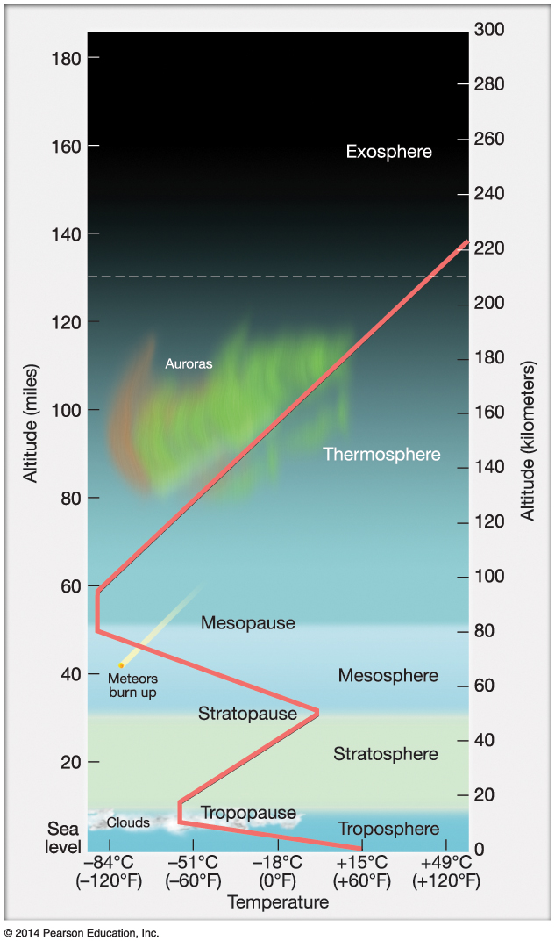

Vertical Structure of the Atmosphere
Thermal layers
Troposphere – lowest 10–15 km of atmosphere; most weather occurs here
Stratosphere – stagnant air
Mesosphere – middle of atmosphere
Thermosphere – “heat”
Exosphere – transitions into interplanetary space
Notes:
Layers- Because of temperature and temperature change in each layer.
Troposphere---Decreases in temp as go higher.
Stratosphere- Increase because of ozone layer---absorbs UV light and heats up.
Stratosphere- increase.

Slide 6
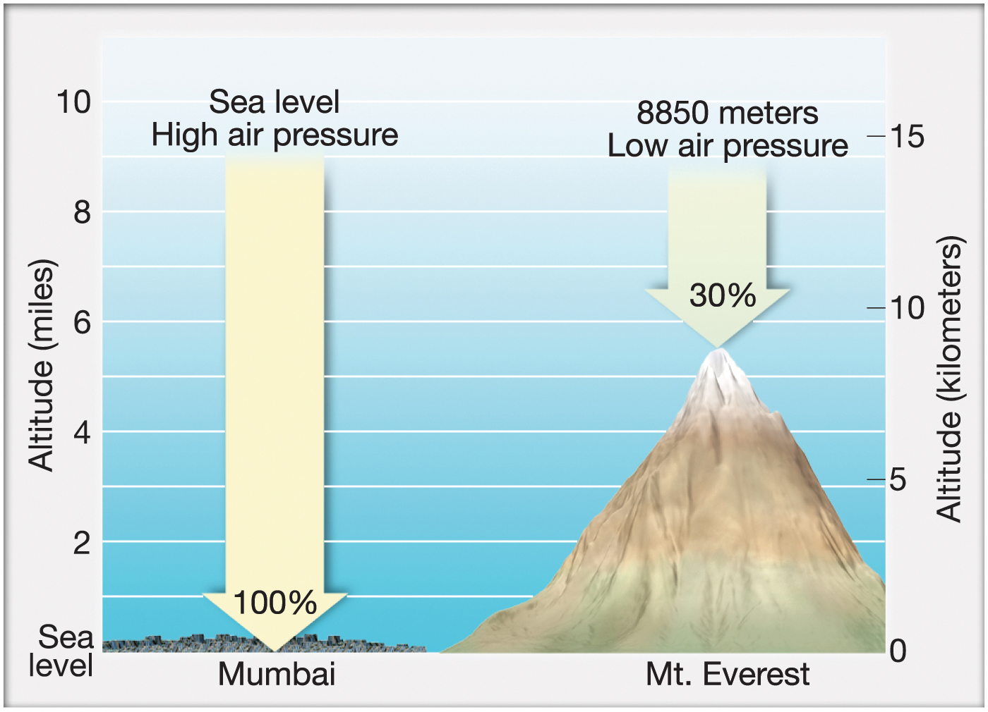

Air Pressure
Notes:
Analogous to the “weight” of the air

Slide 7
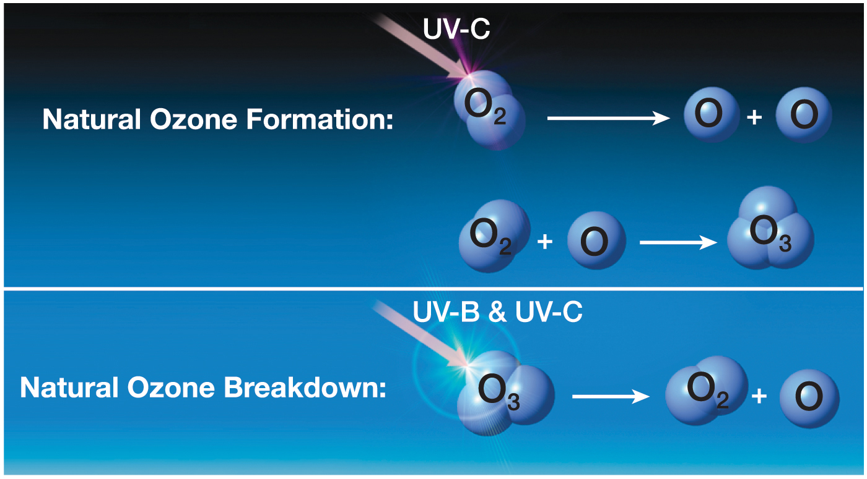

Natural Formation of Ozone

Slide 8
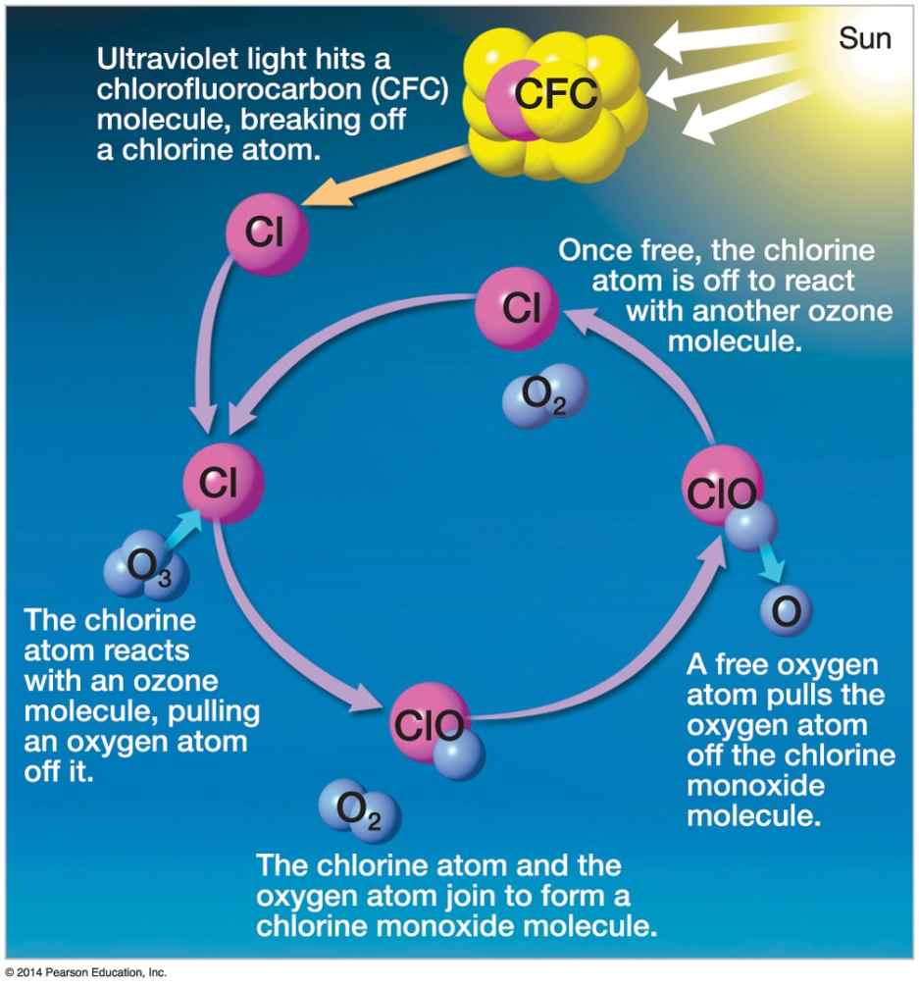

Human-Induced Atmospheric Change
Introduction of impurities into the atmosphere at rapid pace
Received international attention in recent years
Example is the reduction of ozone by CFCs
Page 63 Ozone Hole Video
Notes:
As much as 100,000 ozone molecules can be destroyed for every chlorine atom released.
CFCs- First used in refrigeration and air condition as freon. Other ozone depleting substances include halons (fire extingishers), methyl bromide a pesticide and nitrous oxide.
Rowland and Molina 1995 Nobel prize in chemistry for research. UC Irvine.
CFC thought to be miracle chemicals at athe time….didn’t react with anything on earth…hair spray, propellent.

Slide 9
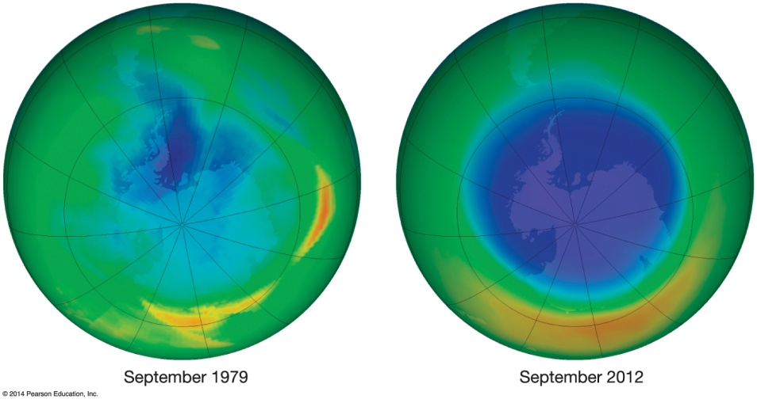

Human-Induced Atmospheric Change
The ozone hole
Release of CFCs resulted in a significant loss of stratospheric ozone, depicted as a “hole”
Ozone loss tends to group near the Antarctic Polar vortex, so hole is most pronounced there
Resultant UV intensity increased in affected regions
Montreal Protocol
Notes:
Success story. Projected to get smaller.
Montreal Protocol- 1987. Timetable for phasing out. 189 countries signed including the U.S. 1996 industralized countries banned CFC production. $700 million pledged to developing countries to help implement alternatives. Will take time. CFC persist for 50 to 100 years in atmosphere. Largest Antarctic ozone hold in 2006 and seems to be stabalizing. Could be 2050. If did nothing 2100 estimated that ozone levels would have collapsed to levels found today in Artic andAntarctic. Exposing large population in the summer to UV levels 3x greater than today.
UV index- Skin cancer.

Slide 10
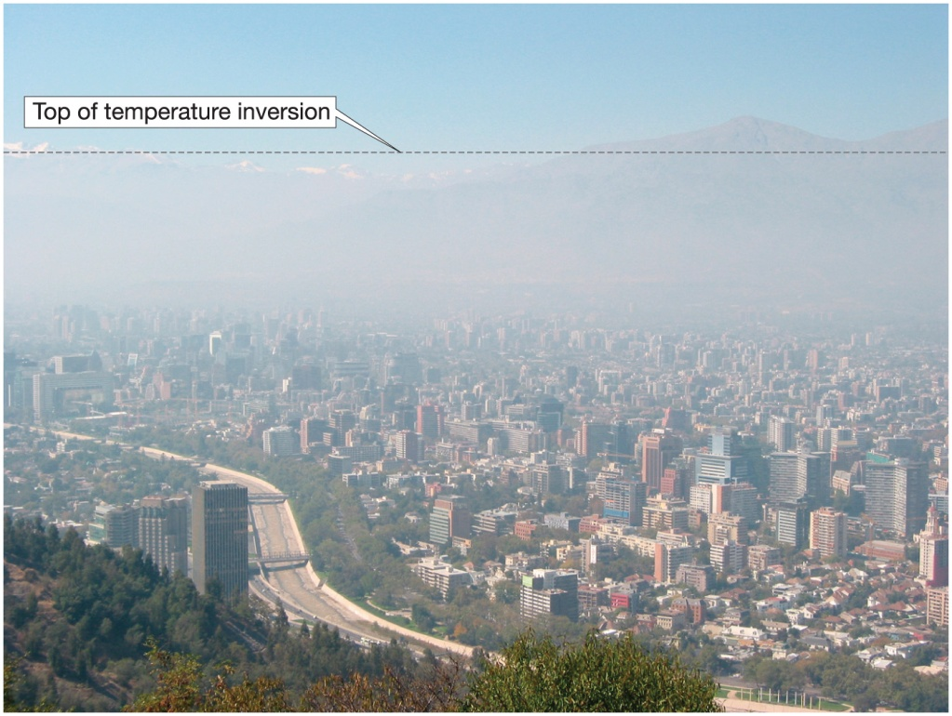

Inversion Layer
Poor air quality
Notes:
Inversion- Cooler air trapped below warmer air.

Slide 11
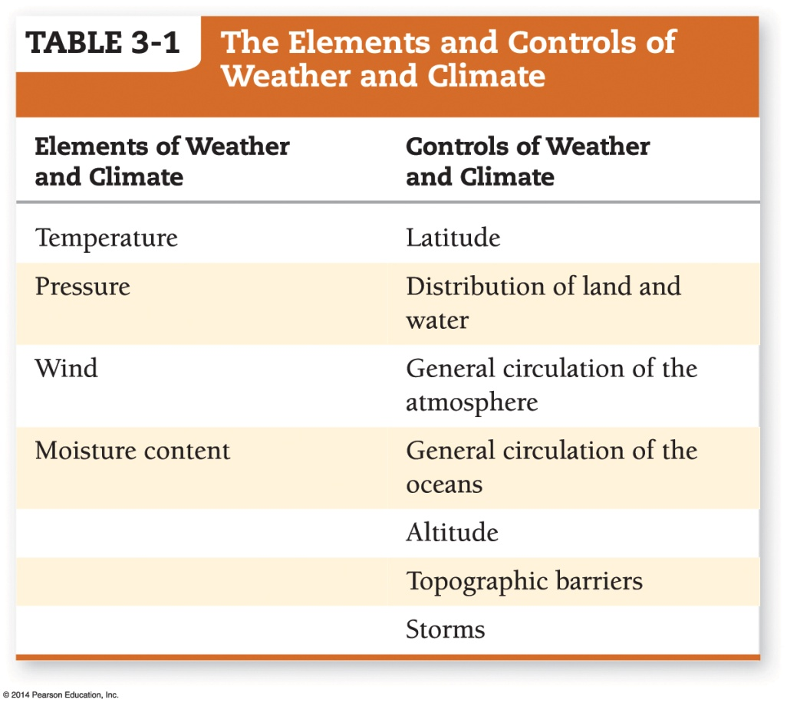

Weather and Climate
Weather – short-term atmospheric conditions for a specific area
Climate – aggregate long-term weather conditions
4 elements
7 controls
Notes:
Elements= Basic ingredients of weather and climate. What we hear in the weather reports. By measuring these elements we can possible decipher some of the complexity of weather dynamics and climatic patterns.
Controls- Variation in elements caused by these controls and differ across the earth.

Slide 12
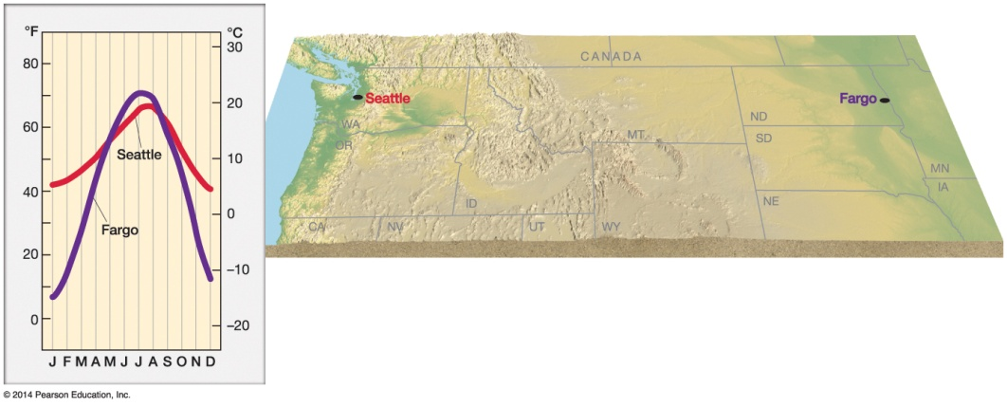

Weather and Climate
Latitude
Regions nearer poles receive less solar radiation, which affects local climate.
Distinction between continental and maritime climates
Seattle, WA, and Fargo, ND, have vastly different climates.
Maritime climates are typically much more humid.

Slide 13
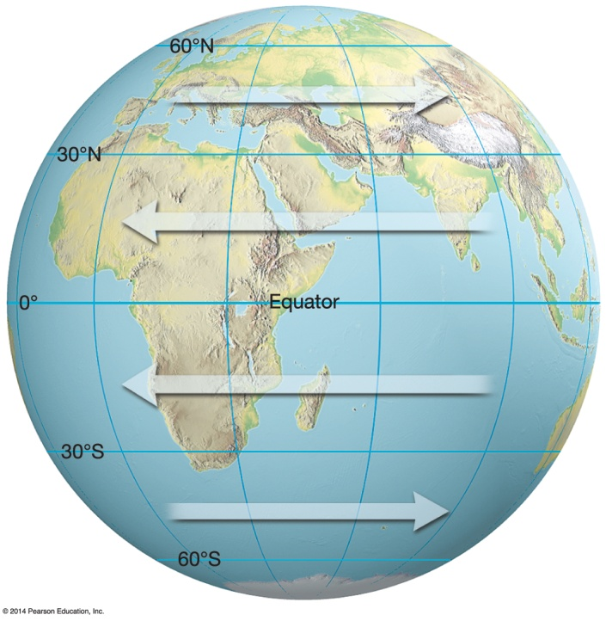
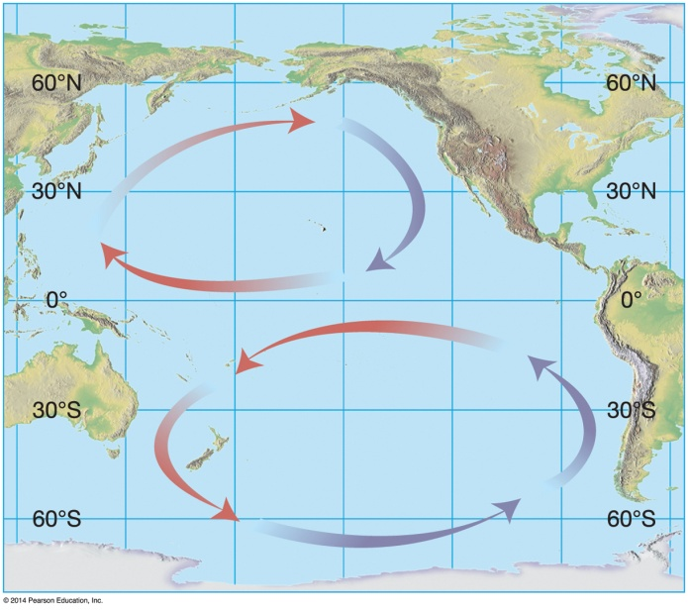

Weather and Climate
General circulation of the atmosphere
Semipermanent wind pattern on Earth
General circulation of the oceans
Oceanic broad-scale semipermanent motions

Slide 14
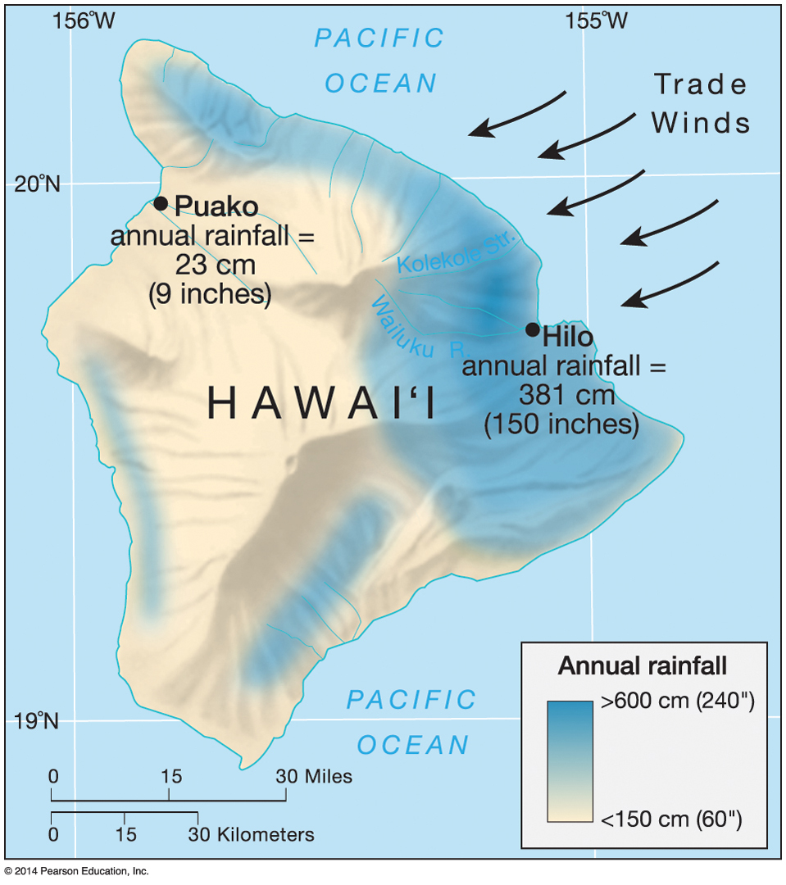

Weather and Climate
Altitude-Particular mountains.
Topographic barriers
Can drastically alter climate due to orographic change in wind patterns
Windward
Leeward

Slide 15
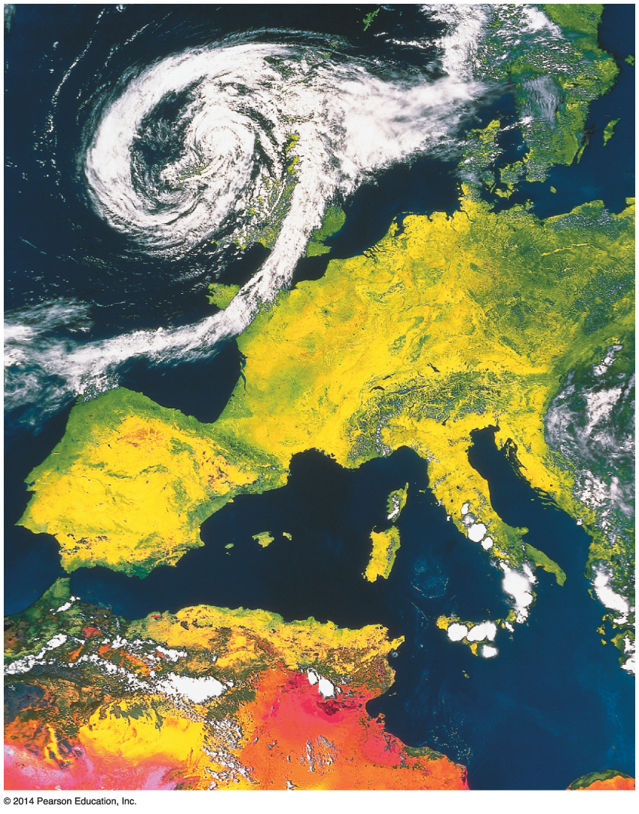

Weather and Climate
Storms
Control weather and climate through atmospheric modification
Some storms prominent enough to affect climate

Slide 16
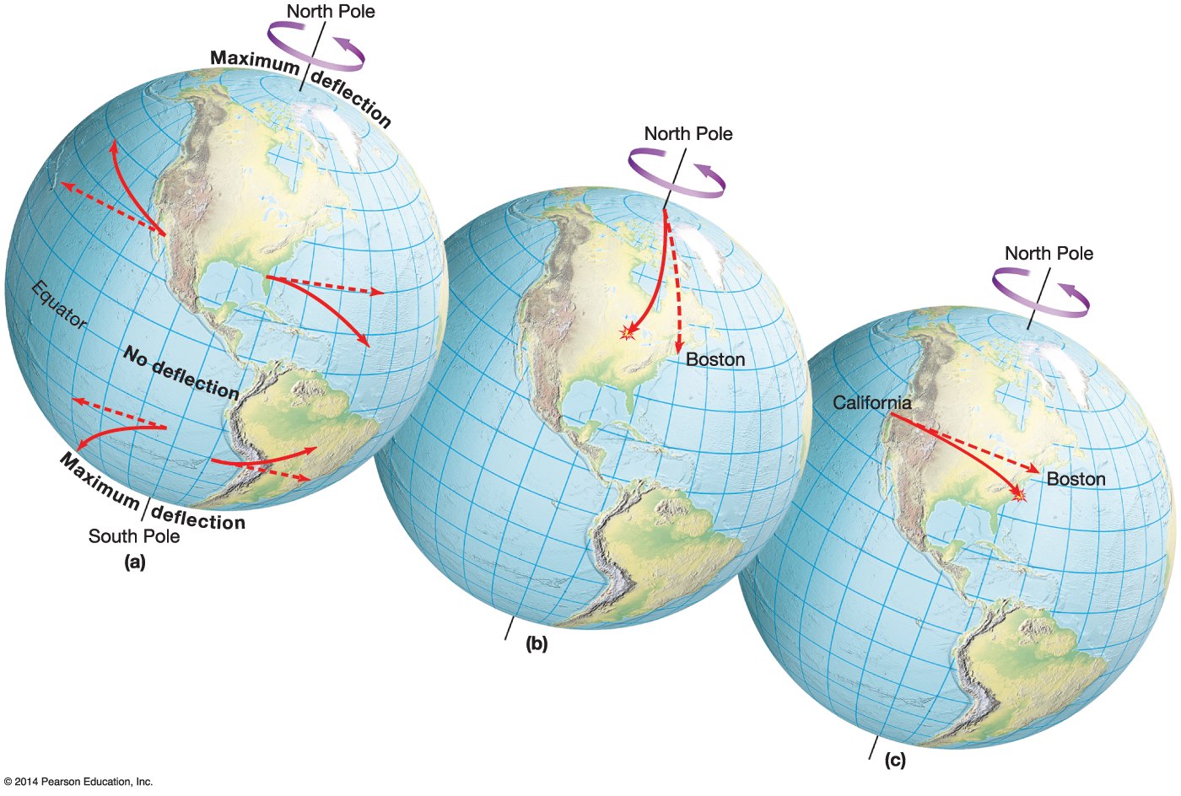


Weather and Climate
The Coriolis ec

Slide 17

Weather and Climate
Coriolis effect
Rotation of Earth modifies path of forward motion over great distances
Causes a rightward turn to motion in the Northern Hemisphere
Causes a leftward turn in the Southern Hemisphere
Deflection greatest at the poles; zero at the equator
Proportional to the speed of the object
Has no influence on speed
Influences wind patterns within storms and hurricanes and can contribute to upwelling of cold ocean water near coasts-
Notes:
Coriolis effect- Is one additional control on weather and climate. Controls on some of the controls.
Deflection of anything moving over the surface of the earth due to the rotation of the earth.

Slide 18

Consequences of Coriolis Effect
Influences wind patterns and ocean patterns.
Airplanes
Missiles
Not your water in sink of bathtub. !

